Slide 1
Fremont High School
Nidya Baez & Caitlin Martindale
January 22, 2020

Slide 2
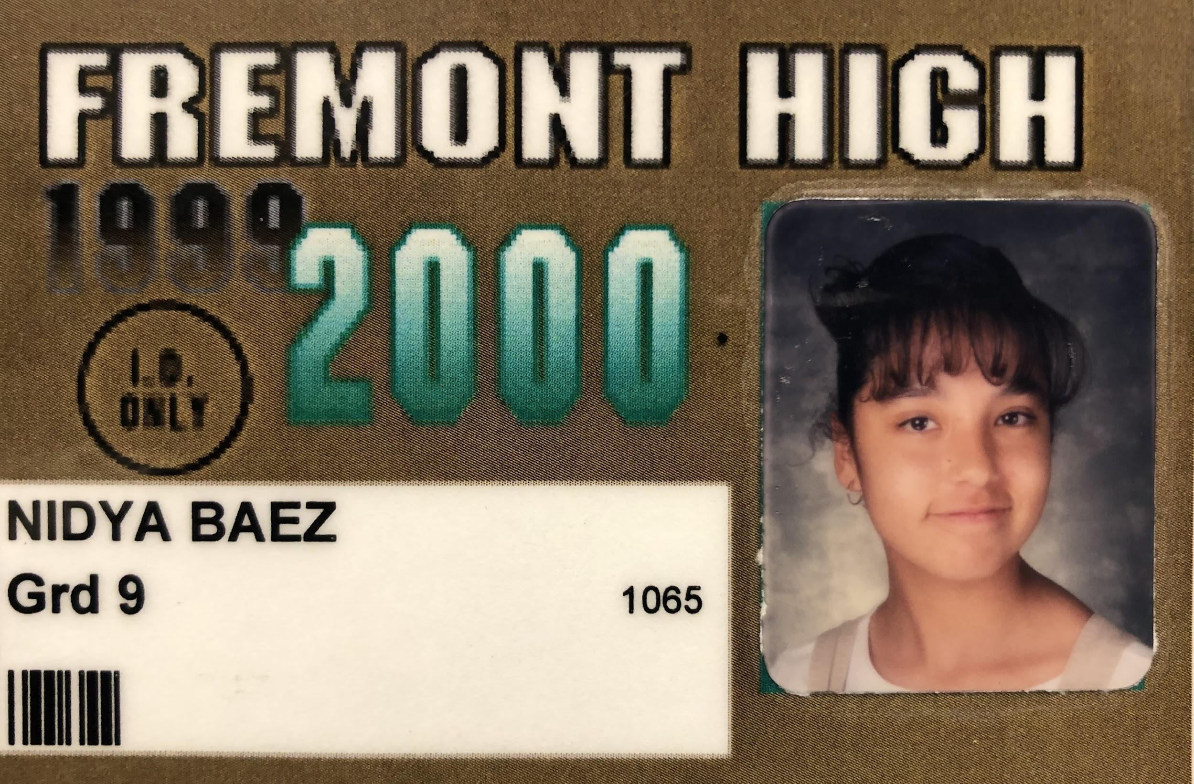
Introductions
Nidya Baez, Assistant Principal, supporting Ninth Grade
I was a 9th grader at Fremont 20 years ago
Caitlin Martindale, Ninth Grade Counselor
I’ve seen Trevor Noah, John Oliver & Air Supply in the last six months
9th Grade House Team: 2 Teacher Leads (Science and Math Teachers), 2 English, 1 Ethnic Studies, 1 Math, 1 Theater, Case Manager, Counselor, Assistant Principal
Notes:
Name, Role at School, One thing interesting about each person

Slide 3
Mission: To provide our diverse community with a rigorous education that instills creativity, critical thinking and technological skills, so that our students enjoy a rich intellectual life and are ready for the colleges and careers of their choosing.
Pathways
Key offerings:
9th Grade Houses Provide Academic Advising & Support
Newcomer Program
Restorative Justice Peer Leadership Program
College Preparation: A-G classes, AP classes, Dual Enrollment
Case Management and Health Center on-site
Sports: Baseball, Volleyball, Soccer, Football, Softball, Cross country, Cheer
$131 million Facilities Community Schools Project: Academic Building, Sports Field, Gymnasium, Wellness Center, Career Technical Education Classrooms, Parking Lot

Slide 4
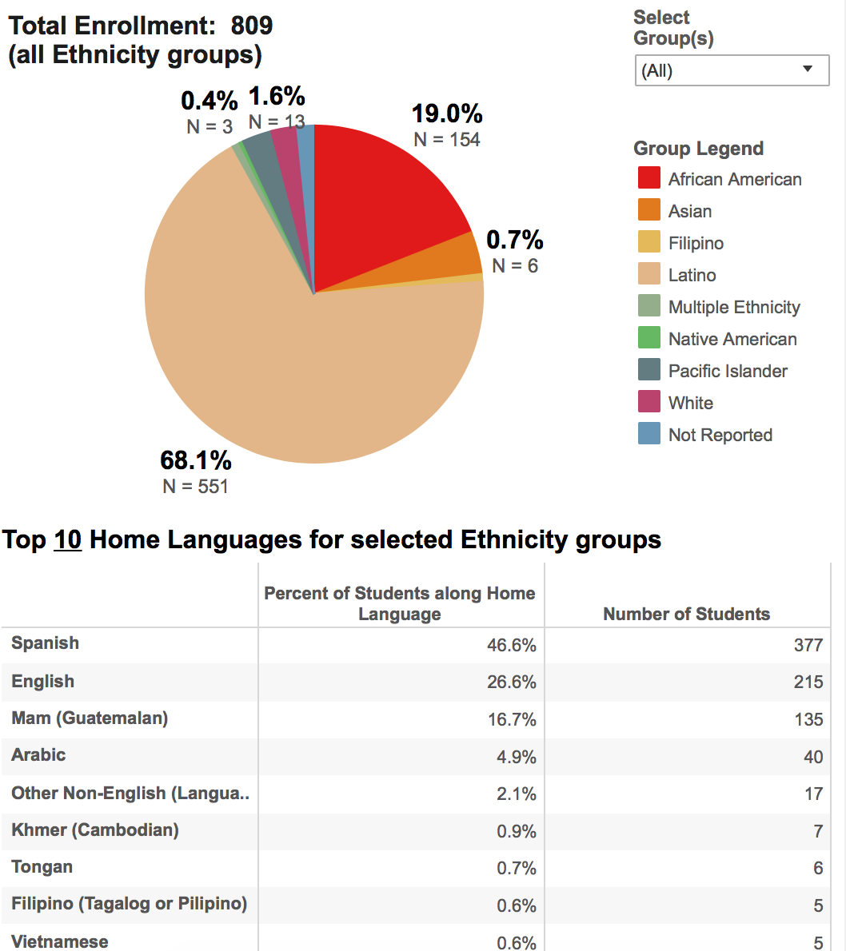
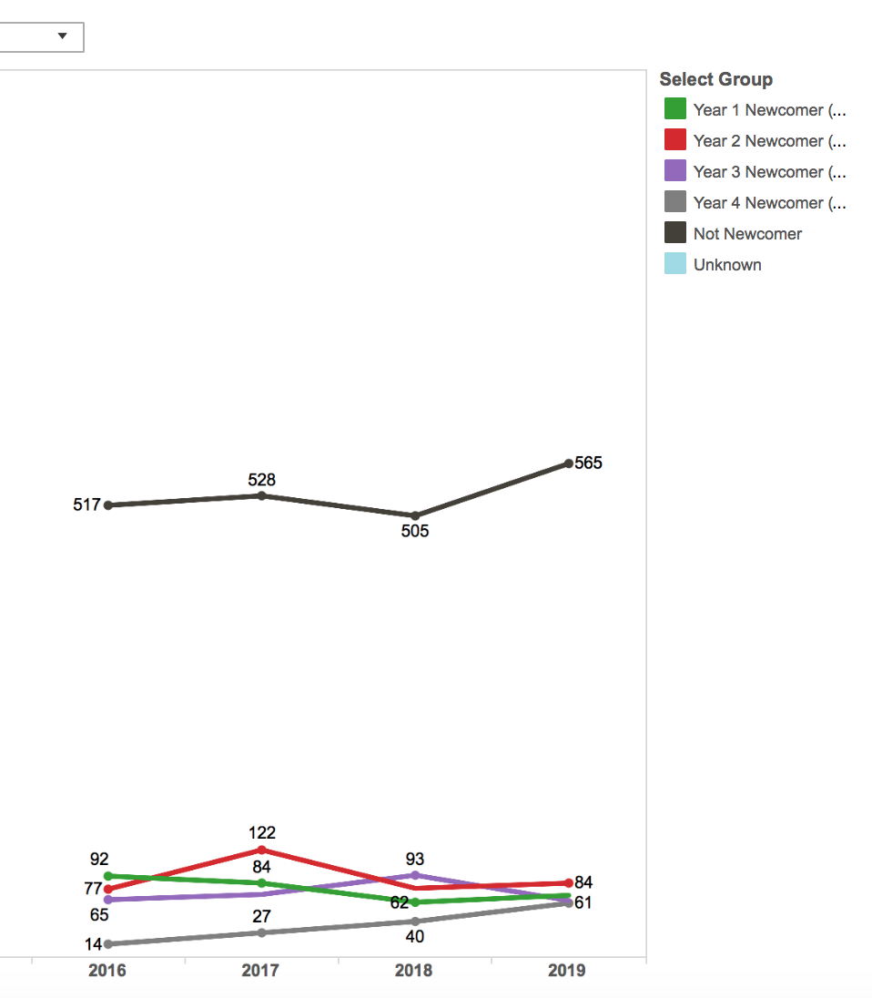
Fremont Context
Mam language continues to grow
Overall increasing Enrollment
Notes:
1-2 minute background about the school (for example; how many freshman, total number of students, who is on your Freshman Team, anything unique about your school-pathway etc)

Slide 5
Change Idea: 2 in 1!
Creating a target list to identify focal students
Using the target list to select students for phone calls home
Notes:
Teachers noticed that kids that were coming every day were still struggling. What are they not doing, since they are here every day?

Slide 6
...which in turn will….
If we …
...that will impact...
Relationships
Create a target list based on attendance, grades, and relationships
Community Belonging & Identity
More Students On-Track
Phone Calls Home for High Attendance, Low Grades Students
Academic Support
Quality Learning Time in Class
Coming Next: Targeted intervention
Notes:
What was your theory around the change- If we _[change idea]_, that will impact _[driver]_, which in turn will lead to _[aim]_.

Slide 7
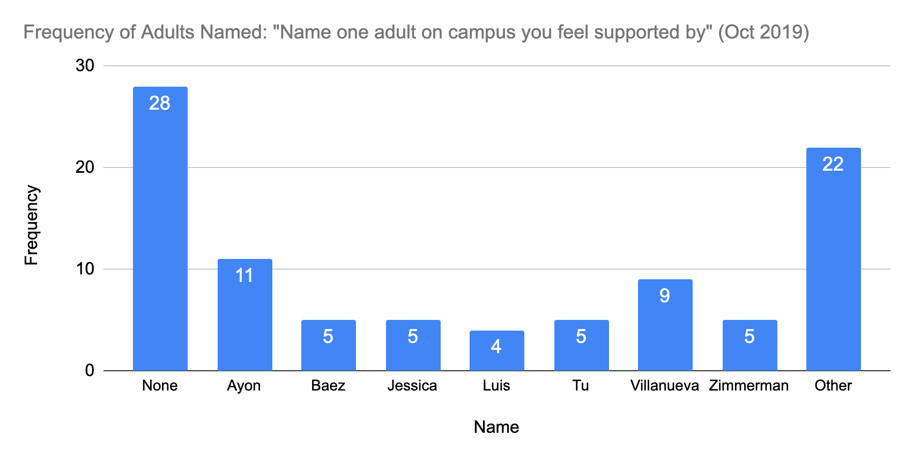
Survey Results on Relationships

Slide 8
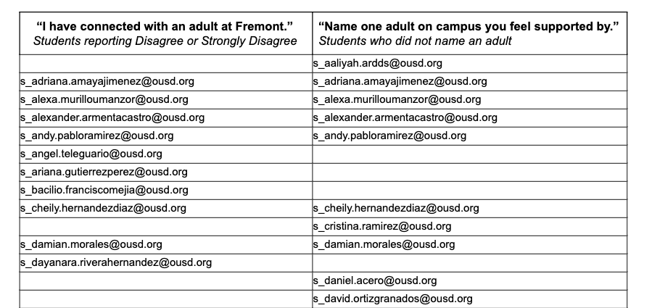
Survey Results on Relationships

Slide 9
Process of Making a Target List
Administered a survey with items about relationships, then identified students who answered they were “less connected.”
Queried SIS for a list of students with high-attendance, but also Ds & Fs
Looked at Team 2.0: an existing group of students that hover just below 2.0 and receive case management support
Created an On-Track Target List with a subset of students from each group:
Chose ~30 focal students, pulling from each group & balancing by gender
Brought list to Freshman Success Improvement Team meeting to discuss and revise
Settled on list of target students
Notes:
Original Pool: 41 low relationships, 22 team 2.0, 12 high-attendance

Slide 10
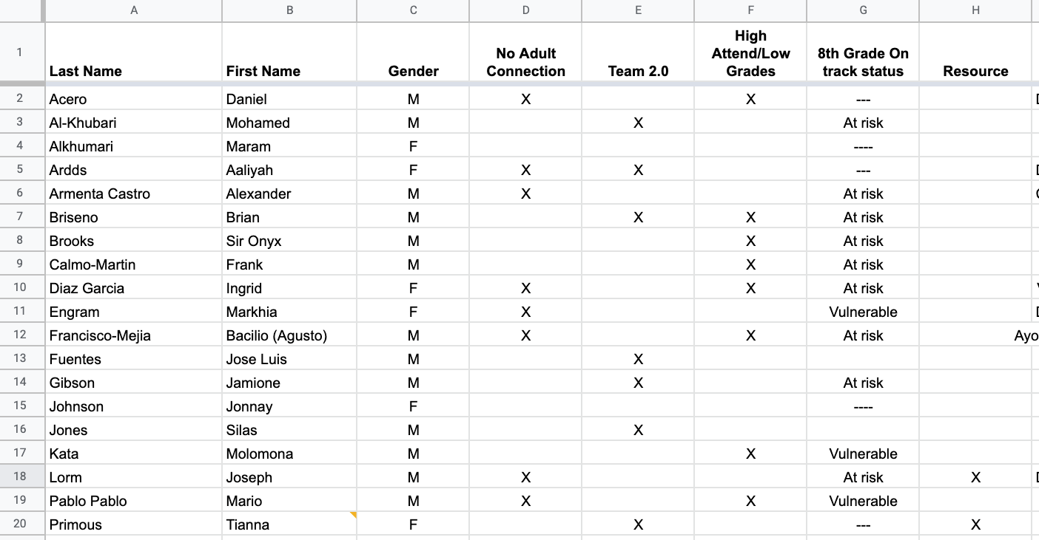
Target List

Slide 11
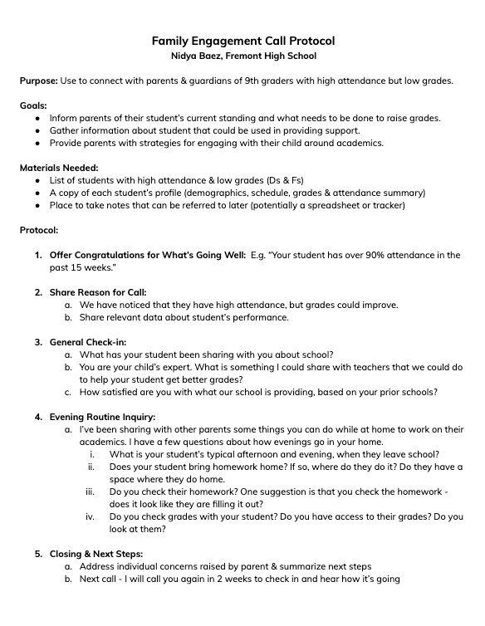
Change Idea: Family Engagement Phone Call
Purpose: Connect with parents/guardians of 9th graders with high attendance but low grades
Goals:
Inform of student’s current standing and what needs to be done to raise grades.
Gather information about student
Provide parents with strategies for engaging student around academics

Slide 12
Materials Needed
Protocol
Up-to-date information about student
Place to record notes to refer to later
Notes:
What were your results? If you have any data please include that here

Slide 13
How we’ve tested so far
Called 8 families over Thanksgiving break: talked to 5, left messages for 3
Short calls - most less than 10 minutes
Findings:
Positive, rapport-building conversation with families we wouldn’t normally call
Most parents reported not knowing - suggested we talk to the student directly
Lack of awareness of academic expectations and importance of finals

Slide 14
Successes
Alejandro: after call, contacted teachers for arrangements due to missing finals
Discovery of key need: family awareness of impact of missing school right before break
One mother had a lot to say - ended up coming into school for a face-to-face meeting
Two parents who we spoke with called us back later in the week to report they had talked to their student
Notes:
What early indications of success have we seen? Anecdotal evidence that this idea helped us make progress?

Slide 15
Advice for Others
If parents report not knowing, consider being more directive: “Can you sit down with your student and ask them if it’s because classes are too hard, or because they are losing their work?”
Follow up with a second phone call two weeks later to circle back
Notes:
If you were to do it again- what suggestions do you have or adaptations you have thought about

Slide 16
Questions
Notes:
Allow 5 minutes for any questions. If no questions you could do a turn and talk here

Slide 17
Contact Information:
Nidya.Baez@ousd.org
Caitlin.Martindale@ousd.org
Fremont High Oakland, CA
510-434-5257

